Slide 1
BOBCAT TIME
April 8 and 9, 2025
STAAR Testing Information

Slide 2
STAAR TESTING DATES
April 15- 7th and 8th grade ELA
April 16- 6th grade ELA
April 22- 8th grade Social Studies
April 23- 8th grade Science/Bio
April 29- 7th and 8th grade Math
April 29- Algebra EOC
April 30- 6th grade Math

Slide 3
STAAR Reminders and Expectations
All students testing on the dates below will need a sack lunch:
April 15- 7th and 8th grade
April 16- 6th grade
April 30- 6th grade
All other dates students will be eating in the cafeteria.
Students that need a sack lunch will have a chance to pre-order lunches this week during lunch. You should have already asked your parents if you need to order a lunch or if you will bring a sack lunch.
Lunches CAN NOT be delivered to students on any testing day. PLAN AHEAD and bring lunch or order from the cafeteria.
Microwaves WILL NOT be available to students on testing days.

Slide 4
STAAR Reminders and Expectations
April 15- 6th gr eats A lunch. 7th and 8th gr eats at 12:30pm in testing room. 7th and 8th graders need sack lunches.
April 16 and April 30- 7th and 8th gr eats B and C lunch as normal. 6th gr eats at 11:30am in testing room. 6th graders need sack lunches.

Slide 5
STAAR Reminders and Expectations
NEW NEW- April 29- 6th gr eats A lunch. 7th and 8th gr will test until 4th period or B lunch. Any student that is NOT finished with the math test at 11:45am will go to an overflow room. They will eat in the testing room at a later time. This is new for our 7th and 8th graders. Students who need a lunch will be escorted to get food at a later time. No sack lunches needed.
April 18 and 23- 8th gr students who are not finished testing will eat lunch in the testing room. A, B, C lunches normal. No sack lunches needed.

Slide 6
STAAR Reminders and Expectations
No lockers during testing times.
Students can go to their locker before 1st, before lunch and after testing.
No tutorials on testing days for ANY grade level.
April 15, 26, 22, 23. 29, and 30

Slide 7
STAAR Reminders and Expectations
During the lunches, teachers will get a count of the number of students still testing. Many times at the end of lunch, we move the students who are still testing into another room. We will have 2 rooms available for students who are still testing.

Slide 8
STAAR Reminders and Expectations
On all STAAR testing days, FCMS will be in a testing environment
All Bobcats are asked to be QUIET in the halls
Some bathrooms will be only for testing students
Some hallways will be closed for testing rooms and testing students only
Some teachers will move rooms for testing

Slide 9
STAAR Reminders and Expectations
It is important for all students taking a STAAR assessment to be on time (before 8:50 am) and be in attendance all day until dismissal at 4:10 pm.
When you arrive early, you have extra time to prepare for testing and can calmly enter your testing room.

Slide 10
STAAR Reminders and Expectations
Make sure you charge your laptop the night before your test.
Bring your laptop AND your charger with you on test days. FCMS does not have chargers for you to borrow.
Only students who are STAAR testing will be able to check out a day use computer in the morning. If we run out of loaners you will have to test on a makeup day.
Make sure you check your computers to see if you need any updates.

Slide 11
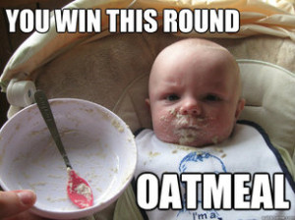
STAAR Reminders and Expectations
Students should come to school well rested after a good night’s sleep of at least 8-10 hours.
Eat a healthy breakfast, not just junk food and sugary items.
Your lunch may be later than you normally eat.

Slide 12
STAAR Reminders and Expectations
Bring a book if you want to read after testing
You can only read (not e-reader or from phone) or sleep/rest after you turn in your test
Phones should be left in your locker or must be turned into testing teacher

Slide 13
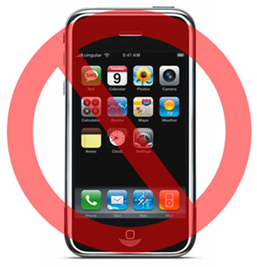
STAAR Reminders and Expectations
An email was sent home informing you and your parent/guardian of Texas Education Agency’s (TEA) and Fort Bend Independent School District’s policy in regards to cell phones and standardizing test including STAAR testing.
You will not get a score for the STAAR test if you are caught with a cell phone or apple watch while testing.

Slide 14
STAAR Reminders
Your teachers have given you many strategies during the school year, make sure you use them.
Take your time on the STAAR test. There is no need to rush. There is no prize for finishing the test 1st.
Take small breaks during your test in order to keep your mind sharp.
Ms. Willett will be at lunches this week to let students know their room number.

Slide 15
HB4545
House Bill 4545 states that any student who does not pass the STAAR test will need to have 30 hours of extra intervention for EACH subject that you fail.
Some students are getting those extra hours now in Bobcat time, 7:30am morning tutorials or Saturday tutorials.
Make sure you take the test serious and do your best.
Take your time, check your work, redo problems, etc…

Slide 16
Turn off TEAMS
Please watch the video about how to turn off TEAMS from opening up.
How to turn off TEAMS

Slide 17
Check for computer updates
Please watch the video about how to check for computer updates.
How to check for updates

